Slide 1
A STRATEGIC CASE STUDY IN FOCUS AND R&D
The Apple Turnaround
From Near-Bankruptcy to Global Giant
Presented by Seedarla Gladson
Extreme focus. Fearless cannibalization. A multi-trillion-dollar outcome.
Notes:
Open on the stakes: this is a turnaround and innovation case, not a product tour. Promise the arc — bankruptcy, focus, iPod cash, iPhone cannibalization, 2026 ecosystem.

Slide 2
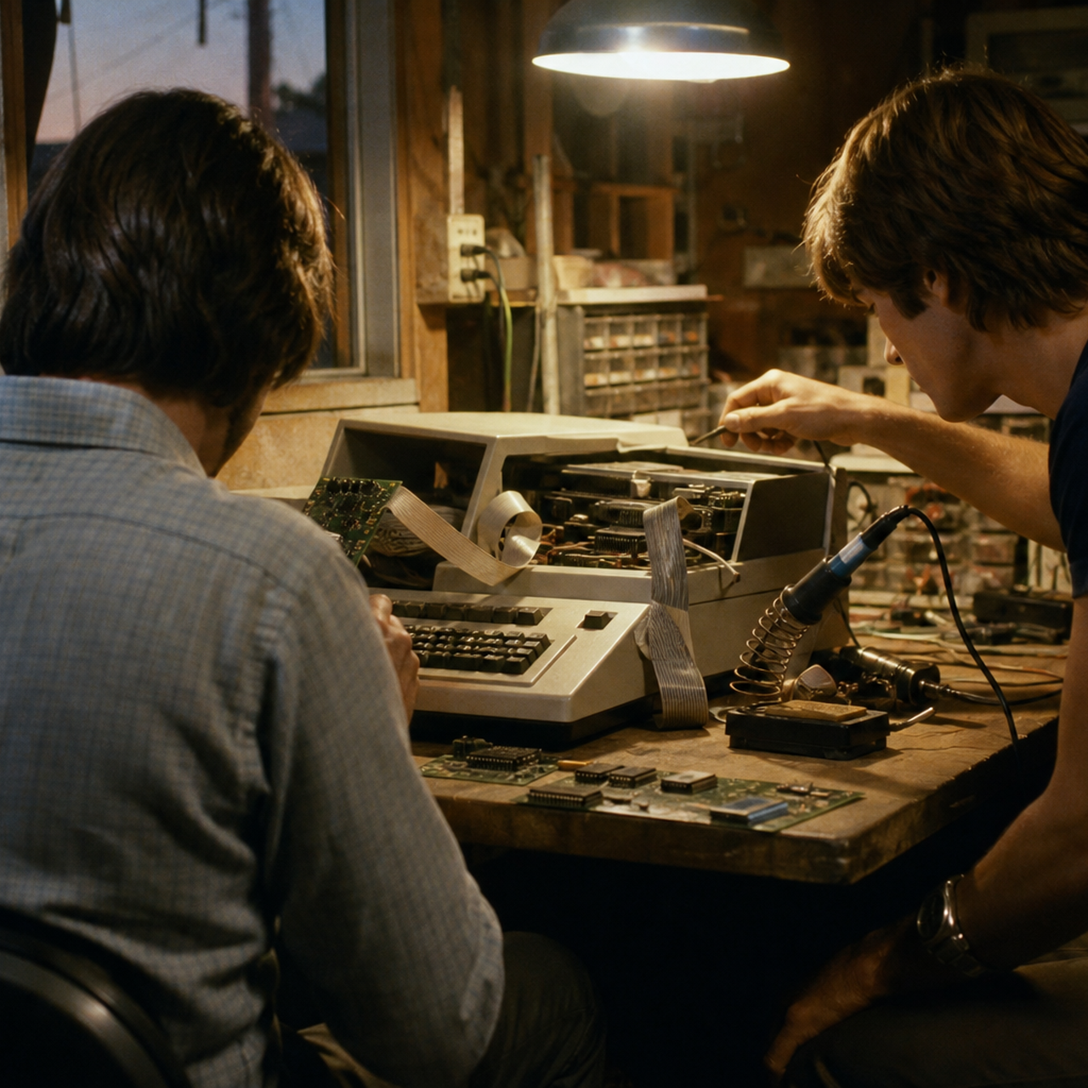
The Starting Era & Early Innovation
Founded in 1976 in a garage by Steve Jobs and Steve Wozniak.
Mission: put an easy-to-use computer in everyday hands.
Macintosh (1984) made the graphical interface and mouse mainstream.
Early brand: rebellious innovation and premium design.
Original illustration — garage-era workshop
02 / 13
Notes:
Beat 1: 1976 mission. Beat 2: 1984 Macintosh as the design standard. Do not linger — this is setup for the fall.

Slide 3
The Ousting of Steve Jobs · 1985
1976
1984
1985
1996
1997
Founded
Macintosh
Jobs forced out
Buys NeXT
Jobs returns
Internal conflict with the board ended with Jobs pushed out of the company he founded.
Without his standard for product quality, leadership lost a single point of view.
The company shifted from making great technology to chasing short-term cash.
That vacuum is what allowed the later product sprawl — and the crash.
03 / 13
Notes:
1985 is the hinge. Emphasize governance: founder vs board, then loss of taste as a management problem, not a trivia story.

Slide 4
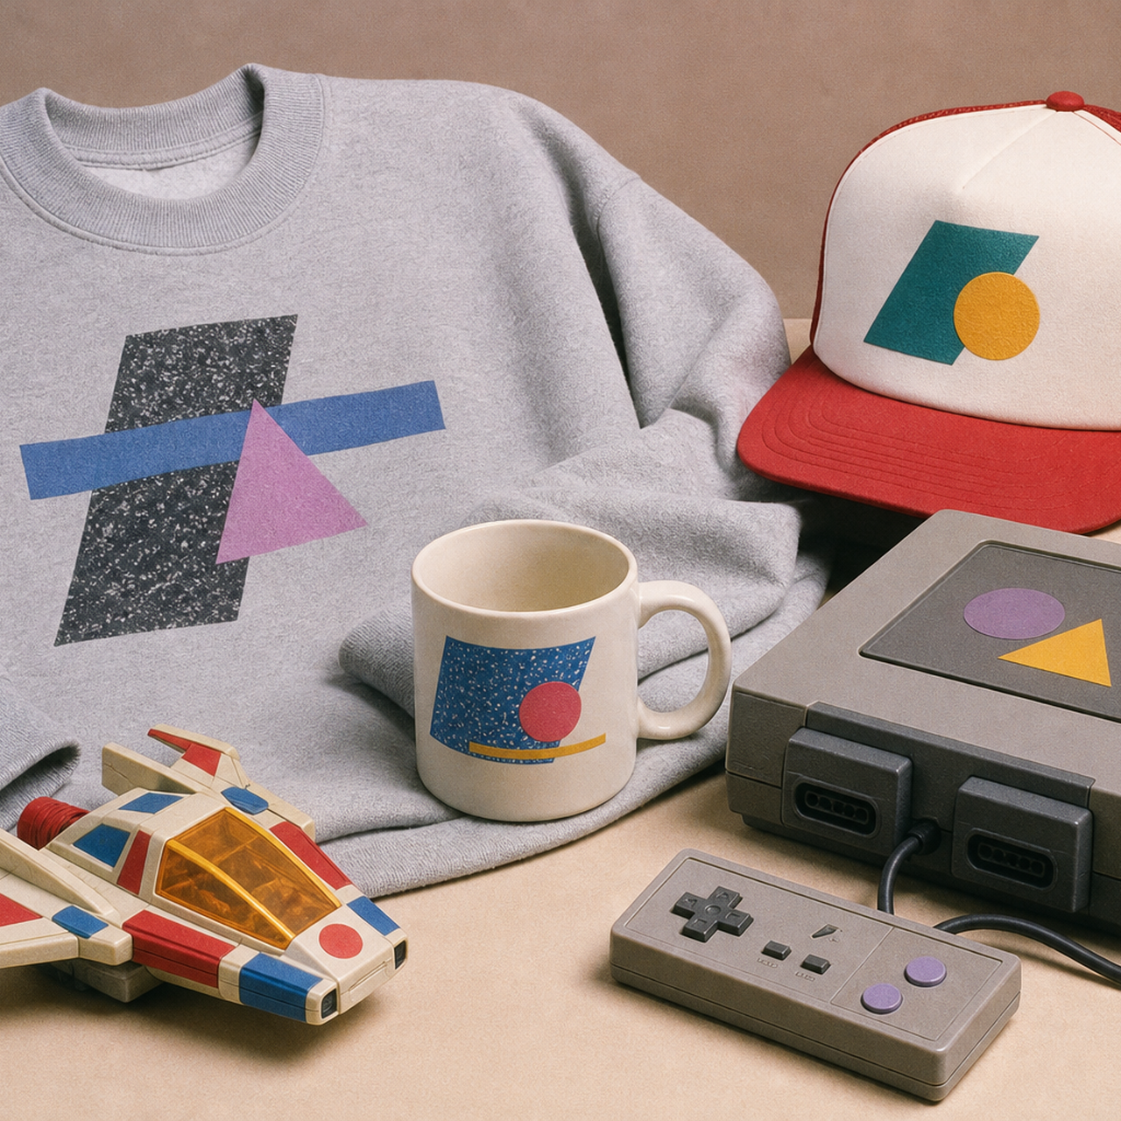
Manufacturing Clothes & Unwanted Stuff
As computer sales slipped, Apple sold non-tech merchandise.
1986: The Apple Collection — sweatshirts, belts, trucker hats.
Also: toys, mugs, and an $1,100 windsurfing board.
In hardware: the Pippin, a failed gaming console.
The brand became bloated, confusing, and unrecognizable.
Original illustration — catalog clutter, not official marks
04 / 13
Notes:
This is the anti-strategy slide: diversification without a core. Pippin and the clothing line are the punchlines that prove the identity crisis.

Slide 5

Nearing Total Bankruptcy · 1997
$1.0B
~90 days
PC era
FY1997 net loss
Cash remaining
Windows volume win
On $7.1B of revenue
Jobs, later interview
Mac became a niche
Too many SKUs filled warehouses with unsold product.
Microsoft-powered PCs took the volume computer market.
Apple was weeks from running out of cash.
05 / 13
Notes:
Lead with the $1.0B FY97 loss (Apple’s own results). The 90-day line is Jobs’s later characterization — say it as such. This is the cliff before the turn.

Slide 6
The Return & The Big Cleanup
“Innovation is saying no to 1,000 things.”
Steve Jobs · after returning in 1997
Apple brought Jobs back in 1997 to save a dying company.
He took control, replaced the old board, and walked the product line.
About 70% of projects were cancelled — clothing, gadgets, stray hardware.
Saying no freed cash, attention, and engineering for a few great machines.
06 / 13
Notes:
Strategy lesson: subtraction. Cancelling 70% is the operating move behind the quote. Transition into the 2x2 as the positive design of that subtraction.

Slide 7
The Strategy of Focus · The 2×2 Grid
Four computers. Two customers. Two form factors. That was the whole company.
Consumer · Desktop
Consumer · Portable
iMac
iBook
The colorful internet machine for the home.
A consumer notebook with a clear identity.
Professional · Desktop
Professional · Portable
Power Mac
PowerBook
Serious power for video, design, science.
The pro notebook — no overlapping SKUs.
Extreme focus cut manufacturing complexity and inventory cost — the financial version of taste.
07 / 13
Notes:
Draw the grid in the air if needed: consumer/pro × desktop/portable. The insight is SKU discipline as a P&L tool, not just a design flourish.

Slide 8

The Financial Lifeline · Partnering with the Enemy
AUGUST 1997
$150M
Microsoft’s non-voting investment — cash, credibility, and time.
Office for Mac continued, so businesses did not have to abandon Apple. The deal bought runway for secret R&D.
Original illustration — 1990s keynote atmosphere
A rival’s check is still a strategy if it preserves the platform you need while you rebuild the product.
08 / 13
Notes:
Name the shock: Jobs on stage, Gates on the screen, the room booing. Then the cold logic: Office for Mac, patent peace, and time to fund R&D.

Slide 9
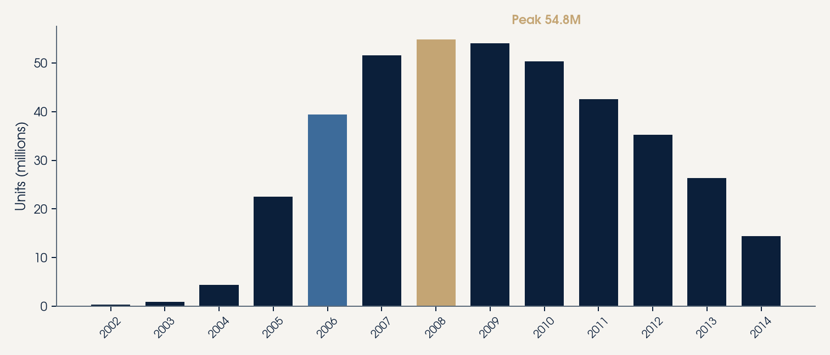
The Profit Engine · The iPod Explosion
450M
55M
40%
Lifetime units
Peak year 2008
Of revenue in 2006
Through 2022 wind-down
Annual unit sales
The year before iPhone
1,000 songs in your pocket became a cash engine. iPod pulled Apple out of the computer-only trap and funded the next bet.
Gold bar: 2008 peak.
Steel bar: 2006 revenue mix.
09 / 13
Notes:
Keep the years straight: 40% of revenue is 2006, peak units are 2008. Lifetime ~450 million. This cash is why they could afford to kill the golden goose.

Slide 10
Fearless Innovation · Cannibalizing the iPod
Phones were going to play music. Apple used iPod profits to invent the device that would replace it.
01
02
03
Phone
Widescreen iPod
Internet browser
A communications device that had to be beautiful.
The entire music habit, no click-wheel required.
The computer, collapsed into one glass slab.
THE LESSON
True innovation is the courage to replace your own bestseller before a rival does. The iPhone (2007) was not a side bet. It was a controlled demolition of Apple’s hottest product.
10 / 13
Notes:
This is the climax. Jobs’s insight: if we don’t kill the iPod, Nokia or someone else will. Three-in-one is the product; cannibalization is the strategy.

Slide 11
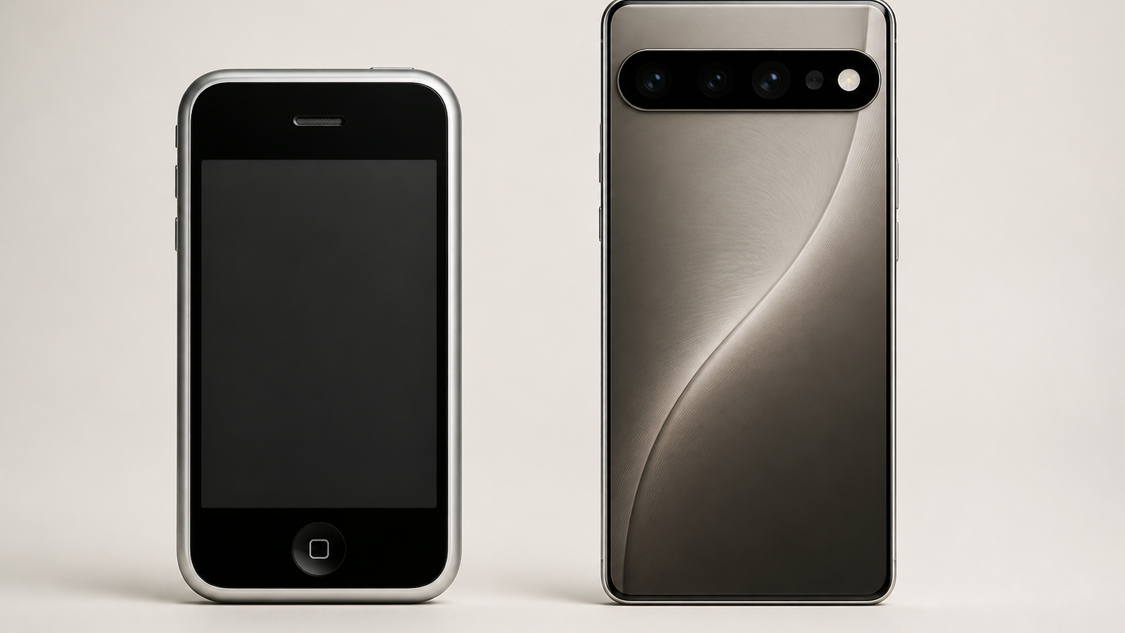
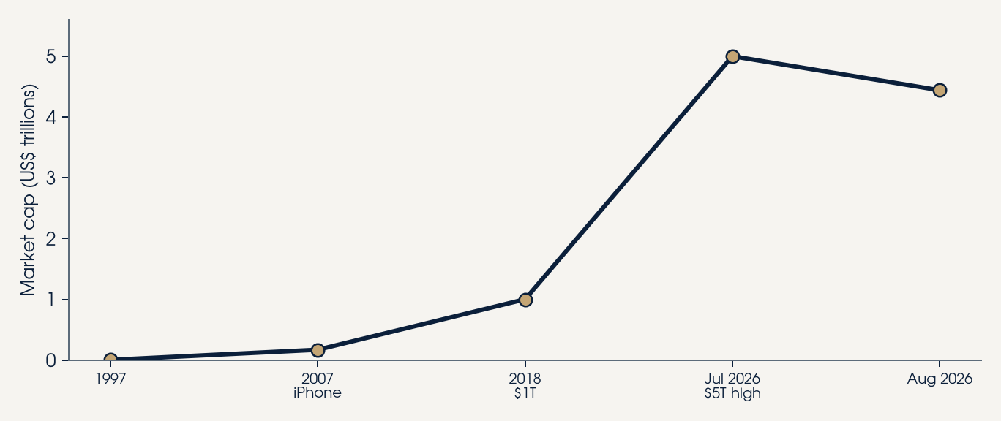
From 2007 to 2026 · The Ecosystem
iPhone 17
iPhone Air
17 Pro
17 Pro Max
iPhone 17e
A19 · Sep 2025
Ultra-thin · Sep 2025
A19 Pro · Sep 2025
Top of line
Entry · Mar 2026
~$4.4T market cap (Aug 2026). Briefly touched $5T in July 2026. Hardware, iOS, and Apple Intelligence lock a high-margin ecosystem — a long way from 90 days of cash.
Original illustration — 2007-style slab vs 2026 thin flagship
11 / 13
Notes:
Name the actual 2026 lineup including Air and 17e. Use $4.4T as the current figure and $5T as the July high — not a stale $3T line. Close on ecosystem lock-in as the business model.

Slide 12
QUESTIONS
Thank you
I am open to questions on the turnaround, the 2×2 focus model, the Microsoft lifeline, or the decision to kill the iPod with the iPhone — through today’s iPhone 17 lineup.
Seedarla Gladson
Notes:
Pause. Invite three lanes: strategy of focus, R&D/cannibalization, and the 2026 ecosystem. Do not reread the bullets.

Slide 13
Sources
Apple Computer, FY1997 (year ended 26 Sep 1997): $1.0B net loss on $7.1B revenue.
Steve Jobs, later interview: Apple was about 90 days from going broke in 1997 (quoted in NYT, 2018).
Microsoft invested $150M in non-voting Apple stock, Aug 1997; committed to Office for Mac (Wired; CNBC).
iPod lifetime sales ~450 million (NYT / Loup Ventures, 2022). Peak ~55M units in 2008 (Statista).
iPod ~40% of Apple revenue in 2006, the year before the iPhone (Statista).
iPhone 17, Air, 17 Pro, 17 Pro Max: announced 9 Sep 2025, released 19 Sep 2025. iPhone 17e: Mar 2026.
Apple market cap ~$4.44T on 17 Aug 2026; briefly touched $5T on 28 Jul 2026 (CNBC; market data).
Illustrations on slides 2, 4, 5, 8, and 11 are original. No official Apple artwork is used.
13 / 13
Notes:
Only open this slide if challenged on a number. Otherwise leave it behind the Q&A.

